Slide 1
Cyclistic Case Study
Teresa Cristina Cohen
Google Data Analytics from Coursera

Slide 2
Cyclistic Overview:
Offers three Bike-share service plans
Single-ride passes
Full-day passes
Annual membership
Two types of riders identified in data
Casual
Use single-ride and full-day passes
Members
Use their membership for unlimited rides
Teresa Cristina Cohen
Google Data Analytics from Coursera

Slide 3
Cyclistic Considerations:
Finance thoughts:
Annual members are more profitable than casual riders
Converting the maximum number of casual riders to members will be key to future growth of the company according to their financial analysts
Marketing thoughts:
Casual riders are already familiar with Cyclistic
Very good chance to convert casual riders into members
Marketing objectives:
Design marketing strategies aimed at converting casual riders into annual members
Understand how annual members and casual riders differ
Marketing questions:
How do annual members and casual riders use Cyclistic bikes differently?
Why would casual riders buy Cyclistic annual memberships?
How can Cyclistic use digital media to influence casual riders to become members?
Teresa Cristina Cohen
Google Data Analytics from Coursera

Slide 4
About the data:
12 months of historical data provided from Nov 2020 to Oct 2021
The tables contain the following headers: ride_id, rideable_type, started_at, ended_at, station_name, statrt_station_id, end_station_name, end_station_id, start_lat, start_lng, end_lat, end_lng, and member_casual type.
In CSV file format
Teresa Cristina Cohen
Google Data Analytics from Coursera

Slide 5
Data Limitations:
No rider identification listed
Inability to track number of rides per rider
Inability to determine payment preference
Inability to do analysis related to where riders live
Assume there are no check-ins required during the course of a ride
Inability to differentiate between single-ride and full-day passes
Teresa Cristina Cohen
Google Data Analytics from Coursera

Slide 6
Data Cleaning:
The data was cleaned to ensure proper analysis could be performed.
The cleaning process consisted of:
White spaces trimmed from beginning and end of each cell
Verified the uniqueness of the ride_id column
The columns rideable_type and member_casual were checked for misspelling
Rows with negative time duration were removed
Outliers were removed based on 1.5*IQR of the calculated ride length (ended_at – started_at)
Observations about the cleaning process:
Rows with missing station information were NOT removed for the analysis related to the ride length
Rows with missing station information were removed for the analysis of most and least visited stations
Teresa Cristina Cohen
Google Data Analytics from Coursera

Slide 7
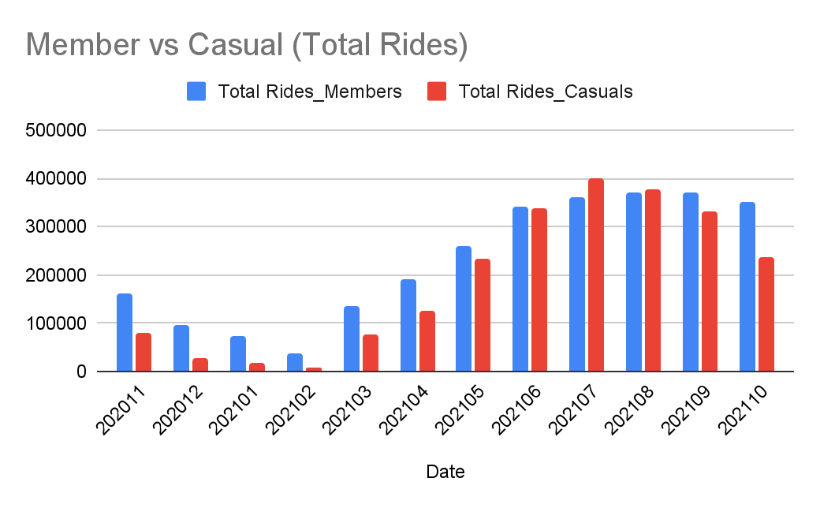
Insights - Ride Quantity:
The total number of rides varies throughout the year. We can visually see a correlation between the total number of rides and the temperature (i.e. more rides in the hotter summer months)
The difference between the total rides from casuals and members decreases as the temperatures increases.
In July the total number of casual rides is greater than the member rides by 10.3%. (July has slightly more casual than member rides)
In October the total number of casual rides is less than the total numbers of rides taken by members 32.7%
Business Question: How do annual members and casual riders use Cyclistic bikes differently?
Teresa Cristina Cohen
Google Data Analytics from Coursera

Slide 8
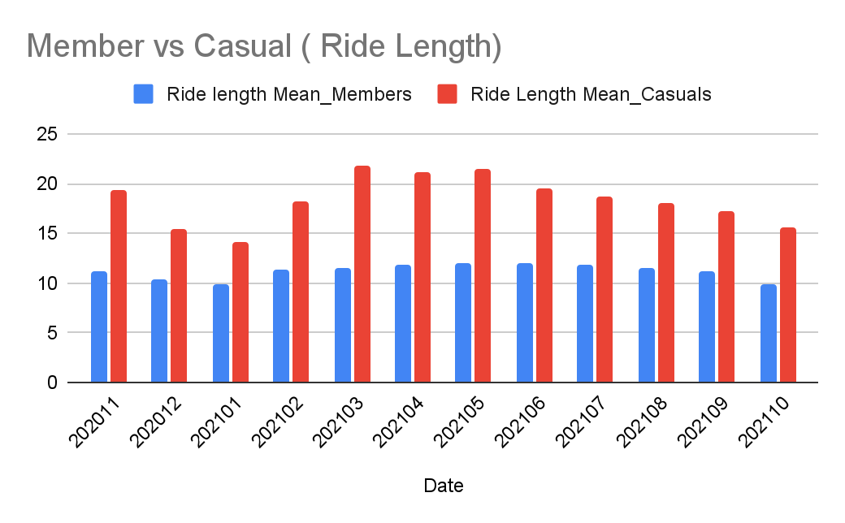
Insights - Ride Length Mean:
The mean ride length was calculated by filtering for members or casuals, summing up the duration of each ride and dividing by the total number of rides (mean)
On average, the duration of casual rides is longer than the rides taken by members by 29.5% in January, 47.26% in March
On average, the duration of the rides from casuals varies between 14:10 and 22:29 minutes, for members the variation is between 10:21 and 12:05
Business Question: How do annual members and casual riders use Cyclistic bikes differently?
Teresa Cristina Cohen
Google Data Analytics from Coursera

Slide 9
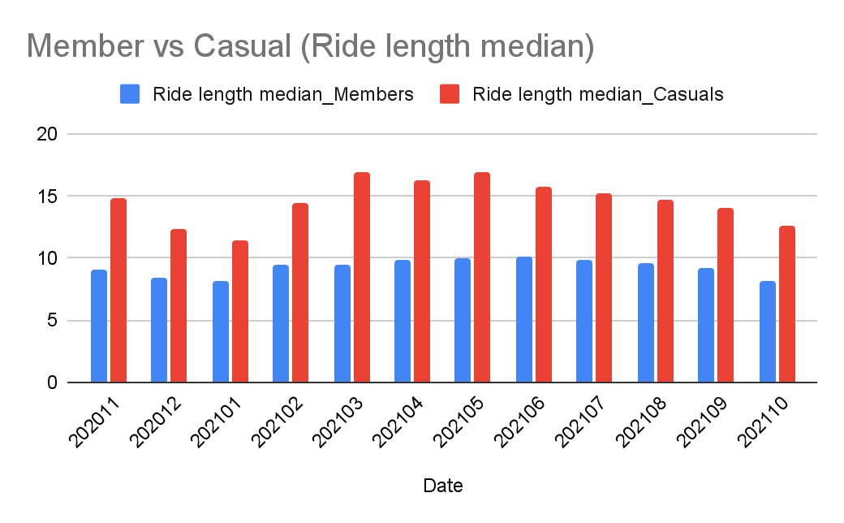
Insights - Ride Length Median:
The median is the middle number in the ride_length list, the number that separates the set in two halves.
The median shows a smaller difference between the ride length of member and casual riders when compared to the mean.
The duration of casual rides is longer than the rides taken by members by 21.7% in January, 44.4% in March
The median shows that duration of the rides from casuals varies between 11:40 and 17:36 minutes, for members the variation is between 08:18 and 10:10
Business Question: How do annual members and casual riders use Cyclistic bikes differently?
Teresa Cristina Cohen
Google Data Analytics from Coursera

Slide 10
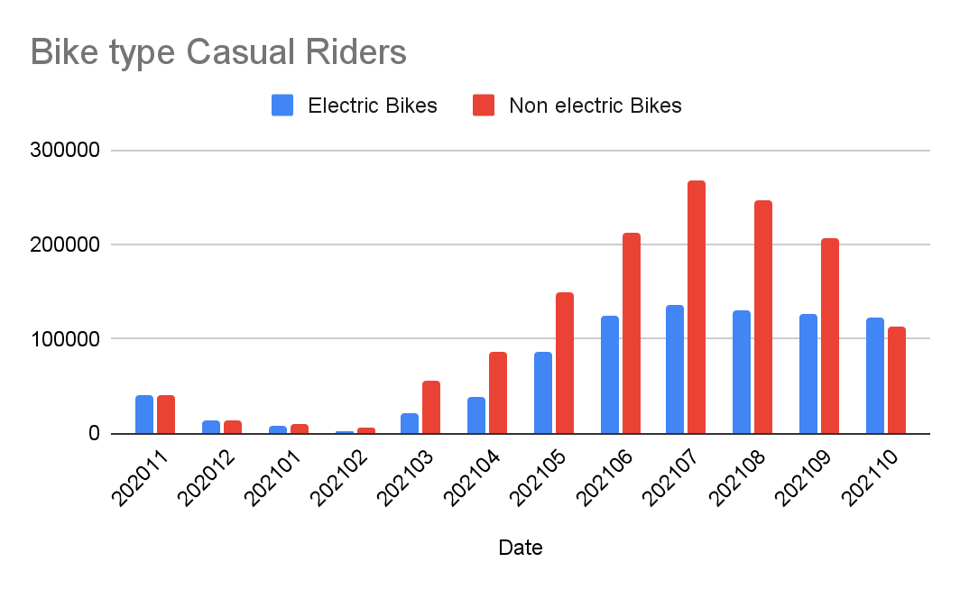
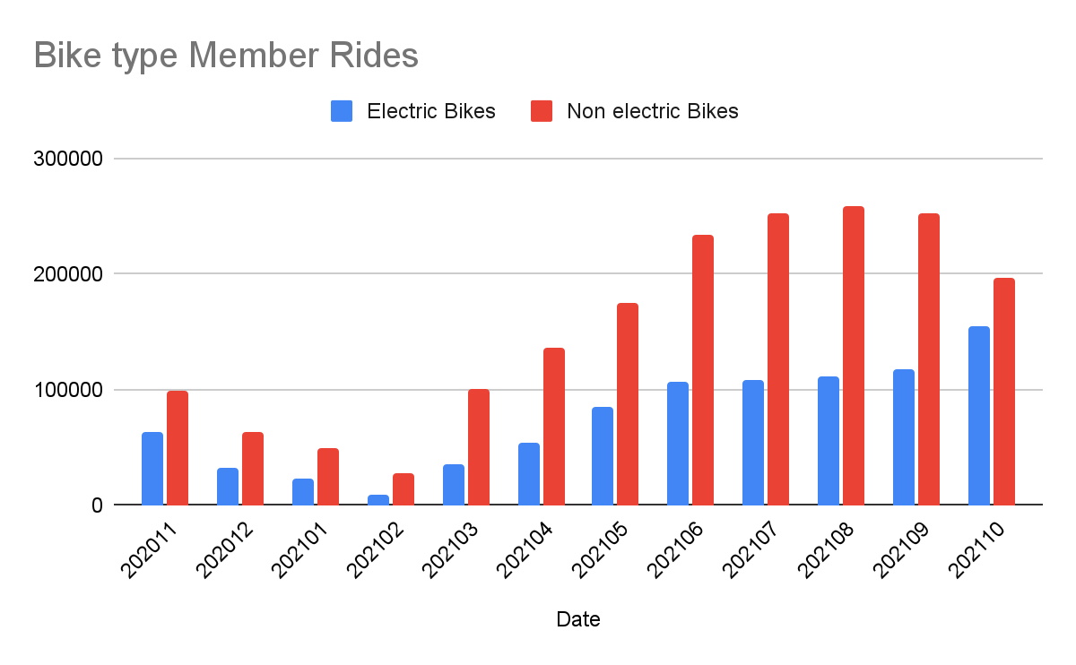
Insights - Bike Type:
The chart relates the total number of rides with electric and non-electric (classic + docked) bike types for member and casual riders.
The number of rides using the non-electric type is higher than electric type for member and casual riders
In March the usage of non-electric type by casual riders was 151.4% greater than the usage for electric type. For members the usage of non-electric was 186.9% greater than electric type.
In October the usage of electric bikes by casuals was greater than the usage for non-electric by 7.95%. For members the usage of non-electric was 27.41% greater than electric type.
Business Question: How do annual members and casual riders use Cyclistic bikes differently?
Teresa Cristina Cohen
Google Data Analytics from Coursera

Slide 11
Insights - Stations:
Most used start station per month for all members:
202010 | 202011 | 202101 | 202102 | 202103 | 202104
1. Clark St & Elm St 2. Lake Shore Dr & Monroe St 3.Theater on the Lake 4.Kingsbury St & Kinzie St 5.Broadway & Barry Ave | 1. Clark St & Elm St 2. Dearborn St & Erie St 3. Kingsbury St & Kinzie St 4. Wells St & Huron St 5. Desplaines St & Kinzie St | 1. Clark St & Elm St 2. Dearborn St & Erie St 3. Wells St & Huron St 4. Kingsbury St & Kinzie St 5. St. Clair St & Erie St | 1.Clark St & Elm St 2. Dearborn St & Erie St 3. St. Clair St & Erie St 4. Columbus Dr & Randolph St 5. Wells St & Elm St | 1.Lake Shore Dr & Monroe St 2. Streeter Dr & Grand Ave 3. Clark St & Elm St 4. Millennium Park 5. Wells St & Elm St | 1.Lake Shore Dr & Monroe St 2. Streeter Dr & Grand Ave 3. Millennium Park 4. Clark St & Elm St 5. Michigan Ave & Oak St
202105 | 202106 | 202107 | 202108 | 202109 | 202110
1. Streeter Dr & Grand Ave 2. Lake Shore Dr & Monroe St 3. Millennium Park 4. Michigan Ave & Oak St 5. Lake Shore Dr & North Blvd | 1. Streeter Dr & Grand Ave 2. Lake Shore Dr & North Blvd 3. Michigan Ave & Oak St 4. Lake Shore Dr & Monroe St 5. Millennium Park | 1. Streeter Dr & Grand Ave 2. Michigan Ave & Oak St 3. Millennium Park 4. Wells St & Concord Ln 5. Theater on the Lake | 1. Streeter Dr & Grand Ave 2. DuSable Lake Shore Dr & North Blvd 3. Michigan Ave & Oak St 4. Theater on the Lake 5. Wells St & Concord Ln | 1.Streeter Dr & Grand Ave 2. DuSable Lake Shore Dr & North Blvd 3. Michigan Ave & Oak St 4. Wells St & Concord Ln 5. Millennium Park | 1.Streeter Dr & Grand Ave 2. Ellis Ave & 60th St 3. Wells St & Concord Ln 4. Clark St & Elm St 5. Millennium Park
Teresa Cristina Cohen
Google Data Analytics from Coursera

Slide 12
Insights - Stations:
Most used end station per month for all members:
202010 | 202011 | 202101 | 202102 | 202103 | 202104
1. Clark St & Elm St 2. St. Clair St & Erie St 3.Theater on the Lake 4.Lake Shore Dr & Monroe St 5.Broadway & Barry Ave | 1. Clark St & Elm St 2. Dearborn St & Erie St 3. St. Clair St & Erie St 4. Broadway & Barry Ave 5. Wabash Ave & Grand Ave | 1. Dearborn St & Erie St 2. Clark St & Elm St 3. Kingsbury St & Kinzie St 4. St. Clair St & Erie St 5. Wells St & Concord Ln | 1. Lake Shore Dr & Monroe St 2. Dearborn St & Erie St 3. St. Clair St & Erie St 4. Wells St & Elm St 5. Broadway & Waveland Ave | 1.Lake Shore Dr & Monroe St 2. Streeter Dr & Grand Ave 3. Clark St & Elm St 4. Millennium Park 5. Michigan Ave & Oak St | 1.Streeter Dr & Grand Ave 2. Streeter Dr & Grand Ave 3. Millennium Park 4. Clark St & Elm St 5. Michigan Ave & Oak St
202105 | 202106 | 202107 | 202108 | 202109 | 202110
1. Streeter Dr & Grand Ave 2. Lake Shore Dr & Monroe St 3. Millennium Park 4. Michigan Ave & Oak St 5. Lake Shore Dr & North Blvd | 1. Streeter Dr & Grand Ave 2. Lake Shore Dr & North Blvd 3. Michigan Ave & Oak St 4. Lake Shore Dr & Monroe St 5. Wells St & Concord Ln | 1. Streeter Dr & Grand Ave 2. Michigan Ave & Oak St 3. Lake Shore Dr & North Blvd 4. Millennium Park 5. Theater on the Lake | 1. Streeter Dr & Grand Ave 2. DuSable Lake Shore Dr & North Blvd 3. Michigan Ave & Oak St 4. Theater on the Lake 5. Wells St & Concord Ln | 1.Streeter Dr & Grand Ave 2. DuSable Lake Shore Dr & North Blvd 3. Michigan Ave & Oak St 4. Wells St & Concord Ln 5. Millennium Park | 1.Streeter Dr & Grand Ave 2. Ellis Ave & 60th St 3. Wells St & Concord Ln 4. Clark St & Elm St 5. Millennium Park
Teresa Cristina Cohen
Google Data Analytics from Coursera

Slide 13
Conclusion:
The difference between the total number of rides taken by members and casual is higher during the cold season.
Casual riders have longer ride length than Members throughout the year
The demand for non-electric bike is higher than Electric bikes type throughout the year with an increase during the hot season
Most common stations include:
Business Question: How do annual members and casual riders use Cyclistic bikes differently?
Teresa Cristina Cohen
Google Data Analytics from Coursera

Slide 14
Conclusion:
Why would casual riders buy Cyclistic annual membership?
Price
Location of the bikes stations
Public health issues
Daily commitments
Avoiding traffic on roads and trains
How can Cyclistic use digital media to influence casual riders to become members?
Advertisements about the importance of exercise
Benefits of having Cyclistics annual membership (deals to become a member, advantages of being a member)
Start the advertisements before summer since the number of casual rides is higher during the summer
Focus advertisements on the most used stations. Streeter Dr & Grand Ave is the most used
Payment convenience
Business Question: How do annual members and casual riders use Cyclistic bikes differently?
Teresa Cristina Cohen
Google Data Analytics from Coursera

